Slide 1
Peer Relationships and Academic Advisor Support Analysis
Mini Project | Data Mining & Analytics (DMA Lab)
By Suraj Bhan Majhi
Roll No:23103143
Github Link:https://github.com/surajbhan1309/DMA-mini-project.git

Slide 2
Introduction
🎯 Objective: Analyze how peer and advisor relationships influence student satisfaction.
📚 Background: Student success depends on both academic effort and social support.
This study explores key interpersonal factors shaping student experiences.
🧠 Tools Used: R (tidyverse, ggplot2)
📊 Dataset: 'Peer Relationships and Availability of Advisors - Student Survey.csv'

Slide 3
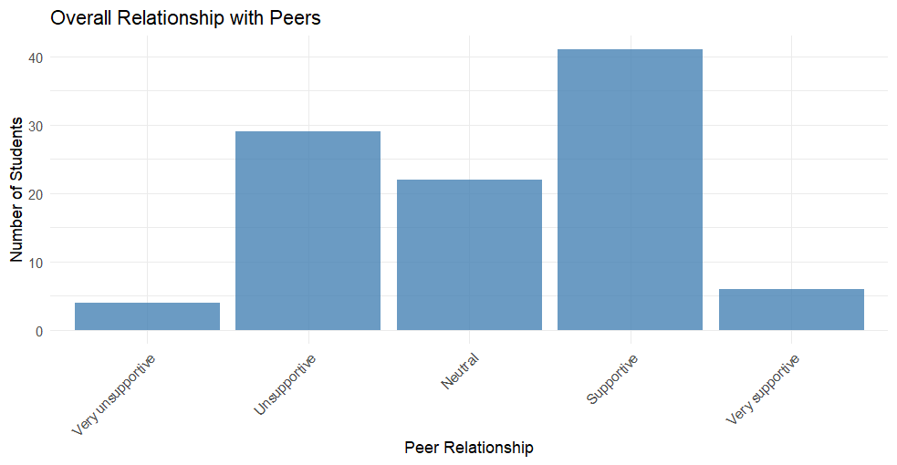
Overall Relationship with Peers
✅ Most students describe their peers as 'Supportive' or 'Neutral'.
⚠️ Few face unsupportive environments.
💡 Insight: Peer mentoring programs could help the minority facing challenges.

Slide 4
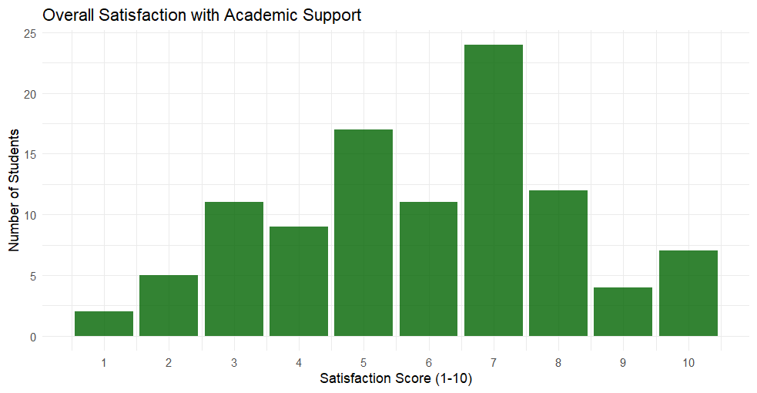
Overall Satisfaction with Academic Support
✅ Majority score between 6–8 on satisfaction.
💡 Insight: Students are mostly satisfied, but low scorers need additional mentoring.

Slide 5
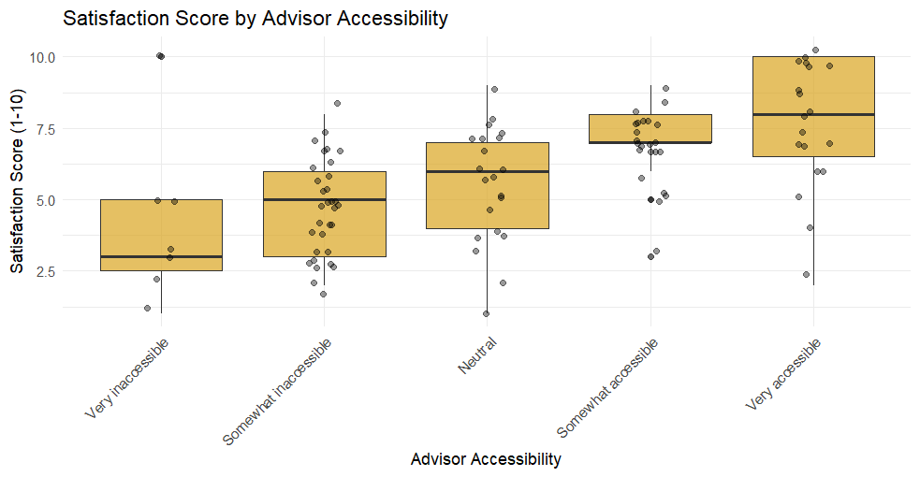
Satisfaction Score by Advisor Accessibility
📈 Clear positive trend: higher accessibility → higher satisfaction.
💡 Insight: Advisor availability is crucial for academic confidence.

Slide 6
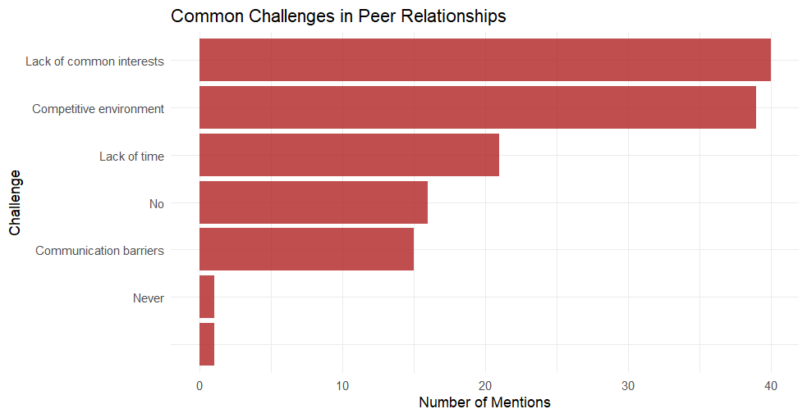
Common Challenges in Peer Relationships
⚠️ Top issues: Competitiveness and lack of communication.
💡 Insight: Group activities can reduce these barriers.

Slide 7
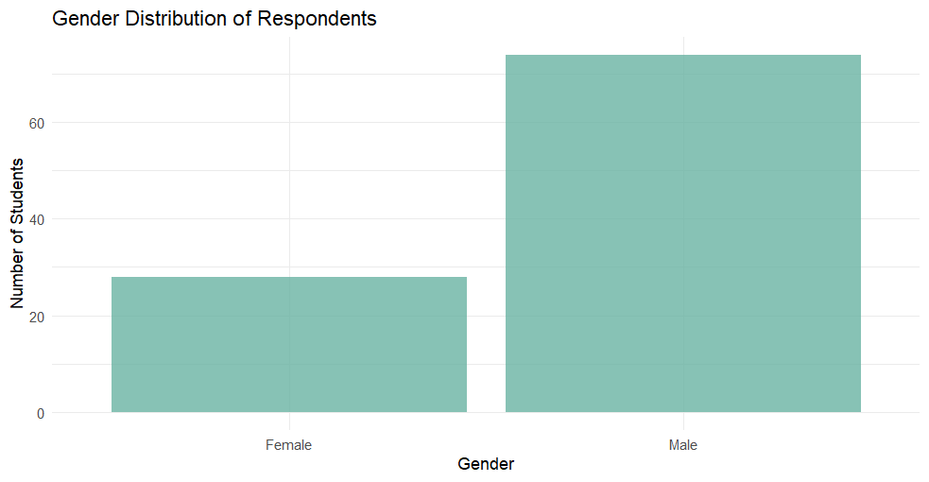
Gender Distribution of Respondents
👥 Males ≈ 70%, Females ≈ 30%.
💡 Insight: Slight male dominance but fairly representative sample.

Slide 8
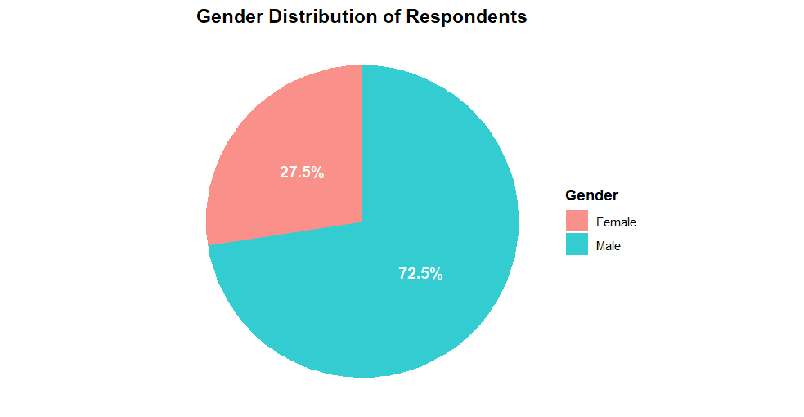
Advisor Contact Methods

Slide 9
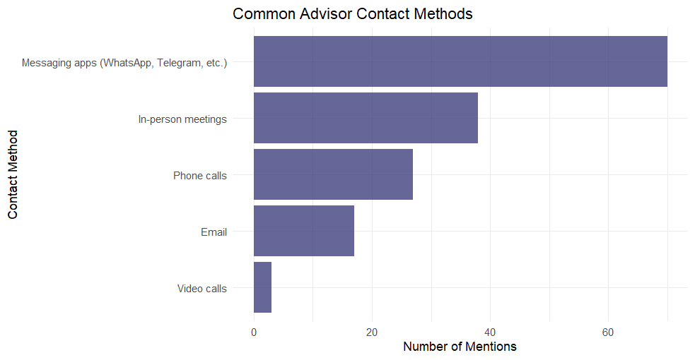
Biggest Difficulty Approaching Advisors
💬 Preferred: Messaging apps and in-person meetings.
💡 Insight: Students favor quick and direct communication channels

Slide 10
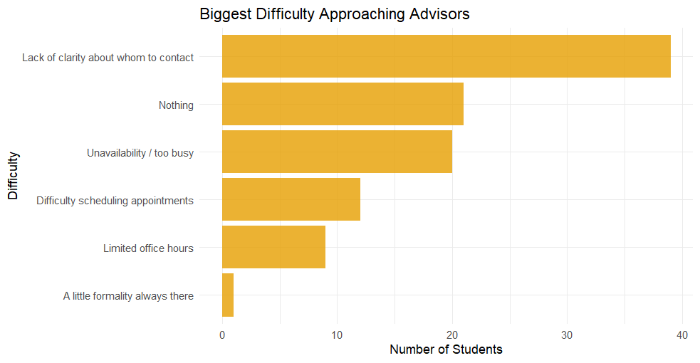
Difficulty in Approaching

Slide 11
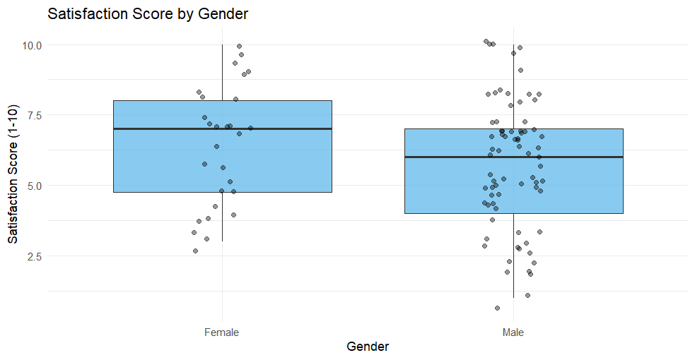
Satisfaction Score by Gender
Female students report slightly higher satisfaction or that there’s no major gender difference..

Slide 12
Key Insights
🔹 Peer relationships are mostly positive.
🔹 Advisor accessibility strongly influences satisfaction.
🔹 Messaging and in-person communication are most effective.
🔹 Gender has little impact on support or satisfaction.
🔹 Addressing peer competition and advisor clarity can further improve student experience.

Slide 13
Conclusion
✅ Supportive peers and accessible advisors enhance student satisfaction.
✅ Institutions should encourage open communication and mentorship programs.
✅ Transparent advisor systems improve academic engagement.
🌟 Overall, collaboration and mentorship build a healthy academic environment.

